Slide 1
E-R Data Model

Slide 2
Definition
An Entity–relationship model (ER model) describes the structure of a database with the help of a diagram, which is known as Entity Relationship Diagram (ER Diagram).
An ER model is a design or blueprint of a database that can later be implemented as a database.
The main components of E-R model are: entity set and relationship set.

Slide 3
Continue..
An ER diagram shows the relationship among entity sets. An entity set is a group of similar entities and these entities can have attributes.
In terms of DBMS, an entity is a table or attribute of a table in database.
So by showing relationship among tables and their attributes, ER diagram shows the complete logical structure of a database.

Slide 4
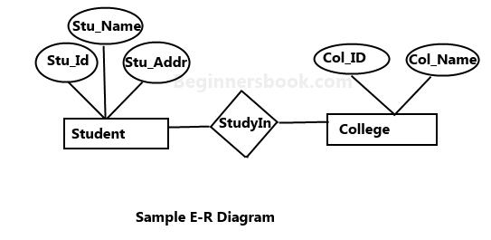
Sample E-R Diagram
In the following diagram we have two entities Student and College and their relationship.
The relationship between Student and College is many to one as a college can have many students however a student cannot study in multiple colleges at the same time.
Student entity has attributes such as Stu_Id, Stu_Name & Stu_Addr and College entity has attributes such as Col_ID & Col_Name.

Slide 5
Components of E-R Diagram
Rectangle: Represents Entity sets. Ellipses: Attributes Diamonds: Relationship Set Lines: They link attributes to Entity Sets and Entity sets to Relationship Set Double Ellipses: Multivalued Attributes Dashed Ellipses: Derived Attributes Double Rectangles: Weak Entity Sets Double Lines: Total participation of an entity in a relationship set.
E-R Model
Entity Attribute Relation

Slide 6
Continue…
Entity : An entity is an object or component of data. An entity is represented as rectangle in an ER diagram.
Weak Entity : An entity that cannot be uniquely identified by its own attributes and relies on the relationship with other entity is called weak entity.
The weak entity is represented by a double rectangle. For example – a bank account cannot be uniquely identified without knowing the bank to which the account belongs, so bank account is a weak entity.
Example
Bank_Acc
Bank

Slide 7
2. Attribute : An attribute describes the property of an entity. An attribute is represented as Oval in an ER diagram. There are four types of attributes:
Key attribute
Composite attribute
Multivalued attribute
Derived attribute

Slide 8
Key Attribute : A key attribute can uniquely identify an entity from an entity set. For example, student roll number can uniquely identify a student from a set of students. Key attribute is represented by oval same as other attributes however the text of key attribute is underlined.
Composite Attribute : An attribute that is a combination of other attributes is known as composite attribute. For example, In student entity, the student address is a composite attribute as an address is composed of other attributes such as pin code, state, country.
Multivalued Attribute : An attribute that can hold multiple values is known as multivalued attribute. It is represented with double ovals in an ER Diagram. For example – A person can have more than one phone numbers so the phone number attribute is multivalued.
Derived Attribute : A derived attribute is one whose value is dynamic and derived from another attribute. It is represented by dashed oval in an ER Diagram. For example – Person age is a derived attribute as it changes over time and can be derived from another attribute (Date of birth).

Slide 9
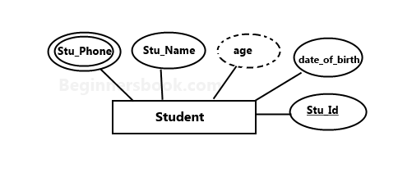
Example : Student Entity with various attributes

Slide 10
3. Relationship : A relationship is represented by diamond shape in ER diagram, it shows the relationship among entities. There are four types of relationships:
1. One to One 2. One to Many 3. Many to One 4. Many to Many

Slide 11
One-to-One Relationship : When a single instance of an entity is associated with a single instance of another entity then it is called one to one relationship. For example, a person has only one passport and a passport is given to one person.
One-to-Many Relationship : When a single instance of an entity is associated with more than one instances of another entity then it is called one to many relationship. For example – a customer can place many orders but a order cannot be placed by many customers.
Many-to-One Relationship : When more than one instances of an entity is associated with a single instance of another entity then it is called many to one relationship. For example – many students can study in a single college but a student cannot study in many colleges at the same time.
Many-to-Many Relationship : When more than one instances of an entity is associated with more than one instances of another entity then it is called many to many relationship. For example, a student can be assigned to many projects and a project can be assigned to many students.

Slide 12
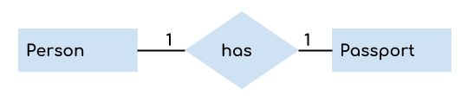
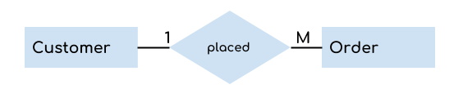
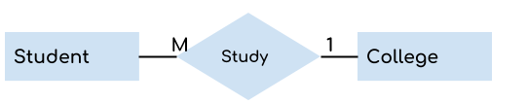
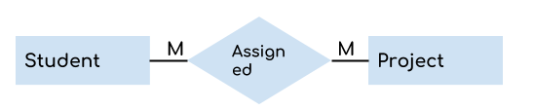
Various Relationship Diagram

Slide 13
Participation
Total : Total participation of an entity set represents that each entity in entity set must have at least one relationship in a relationship set. It is also called mandatory participation.
For example: In the following diagram each college must have at-least one associated Student. Total participation is represented using a double line between the entity set and relationship set.
2. Partial participation of an entity set represents that each entity in the entity set may or may not participate in the relationship instance in that relationship set. It is also called as optional participation
Partial participation is represented using a single line between the entity set and relationship set.

Slide 14
Participation Continue..
Consider an example of an IT company. There are many employees working for the company. Let’s take the example of relationship between employee and role software engineer. Every software engineer is an employee but not every employee is software engineer as there are employees for other roles as well, such as housekeeping, managers, CEO etc. so we can say that participation of employee entity set to the software engineer relationship is partial.

Slide 15
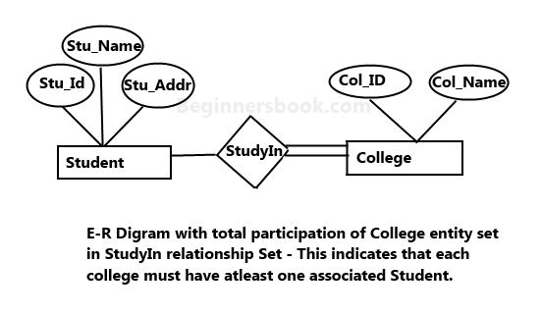
Example

Slide 16
Problem
Drawing of ER model of university database application considering the constraints −
A university has many departments.
Each department has multiple instructors (one person is HOD). Here the HOD refers to the head of department.
An instructor belongs to only one department.
Each department offers multiple courses, each subject is taught by a single instructor.
A student may enroll for many courses offered by different departments.

Slide 17
Solution
Follow the steps given below to draw an Entity Relationship (ER) diagram for a University database application −
Step 1 − Identifying the entity sets.
The entity set has multiple instances in a given business scenario.
As per the given constraints the entity sets are as follows −
Department
Course
Student
Instructor
Head of the Department (HOD) is not an entity set. It is a relationship between the instructor and department entities.

Slide 18
Step 1 − Identifying the entity sets.
The entity set has multiple instances in a given university database.
As per the given constraints the entity sets are as follows −
Department
Course
Student
Instructor

Slide 19
Step 2 − Identifying the attributes for the given entities
Department − the relevant attributes are department Name and location.
Course − The relevant attributes are course_No, course Name, Duration, and prerequisite.
Teacher − The relevant attributes are Teacher Name, Room No, and telephone number.
Student − The relevant attributes are Student Roll_No, Student Name, and date of birth.

Slide 20
Step 3 − Identifying the Key attributes
Department Name is the key attribute for Department.
Course_No is the key attribute for Course entity.
Teacher_Name is the key attribute for the Teacher entity.
Student_No is the key attribute for Student entities.

Slide 21
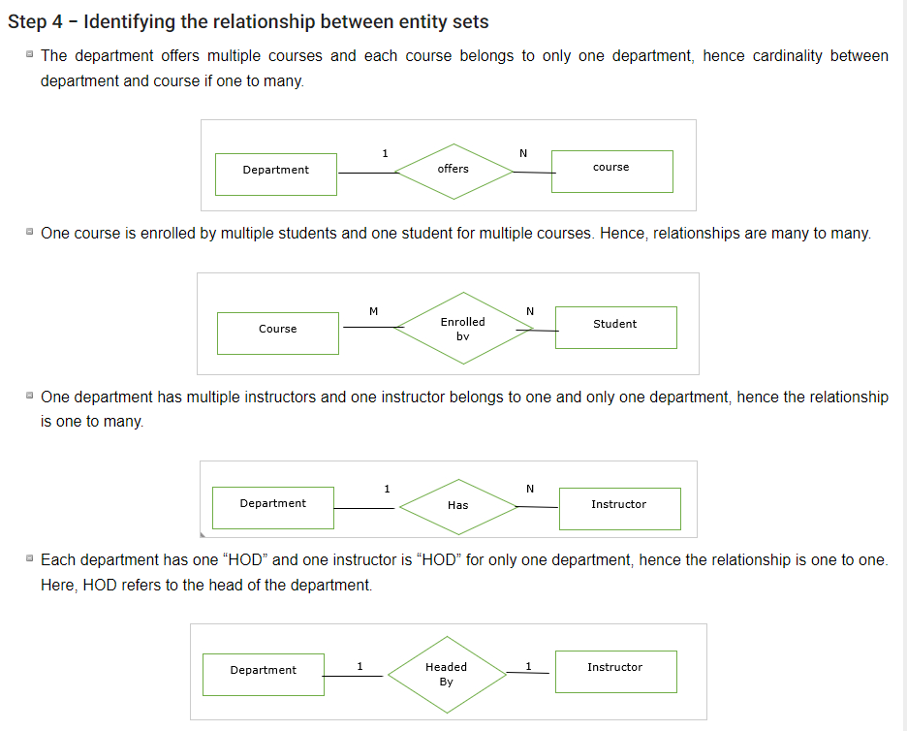

Slide 22
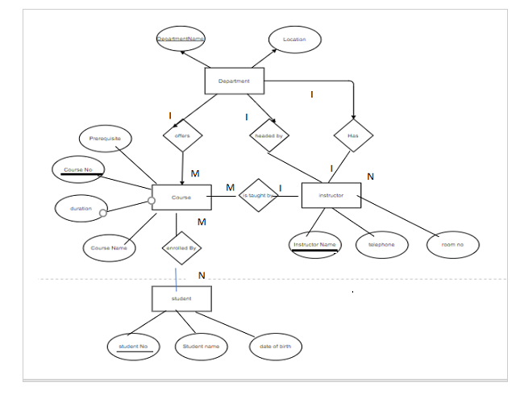
E-R Diagram for University

Slide 23
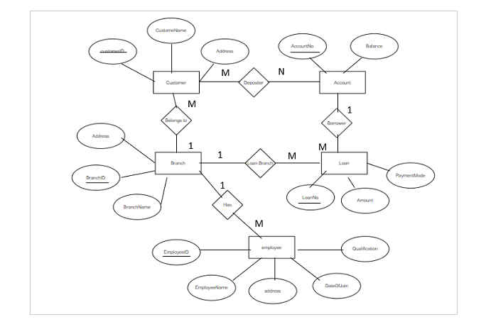
E-R Diagram for Banking System

Slide 24
Strong & Weak Entity Set
Strong Entity:
A strong entity is not dependent on any other entity in the schema. A strong entity will always have a primary key. Strong entities are represented by a single rectangle. The relationship of two strong entities is represented by a single diamond. Various strong entities, when combined together, create a strong entity set.
Weak Entity: A weak entity is dependent on a strong entity to ensure its existence. Unlike a strong entity, a weak entity does not have any primary key. It instead has a partial discriminator key. A weak entity is represented by a double rectangle. The relation between one strong and one weak entity is represented by a double diamond. This relationship is also known as identifying relationship.

Slide 25
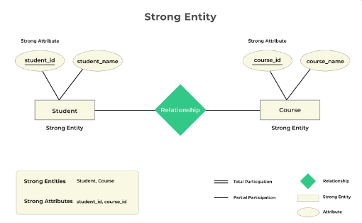
Strong Entity set & Relationship

Slide 26
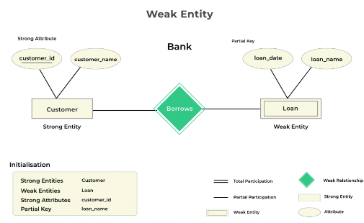
Weak Entity set & Relationship

Slide 27
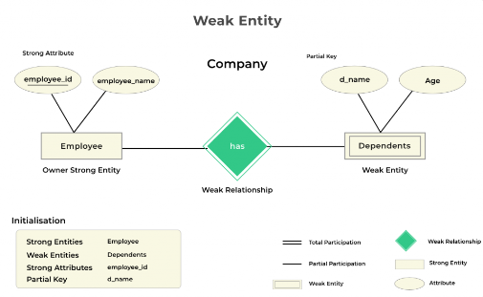

Slide 28
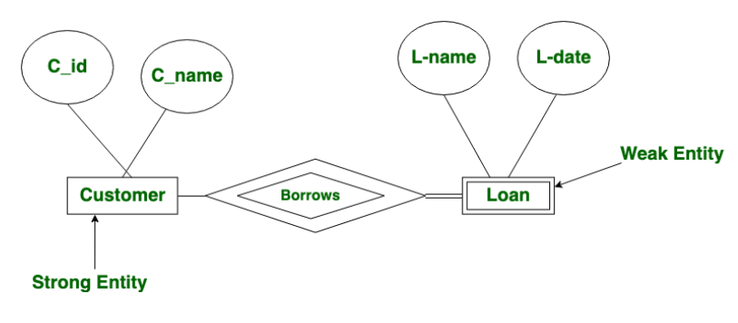
Example

Slide 29
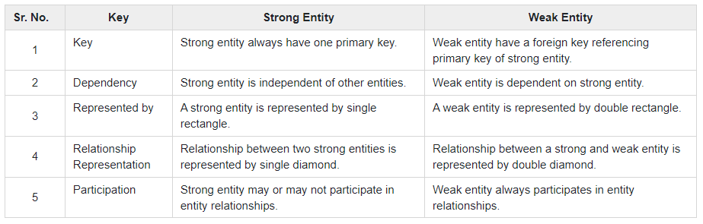
Difference between Weak & Strong entity

